Slide 1
SAN FRANCISCO HOUSING MARKET ANALYSIS
Anh Phuong Ta
Arya Pravin Pohekar
Woodiane Daher
Punithsai Chokki
Nivash Ramabalasubramanian
Group 4

Slide 2
TABLE OF CONTENTS
01
ABOUT the PROJECT
02
DATA DASHBOARD
03
04
SUGGESTIONS
CONCLUSIONS
Background info, cleaning proces
Dashboard panels and data analysis
Provide recommendations
Project conclusion
& Answers

Slide 3
01
ABOUT THE PROJECT

Slide 4
SAN FRANCISCO
& HOUSING PROBLEMS
It takes longer and costs more to build housing in SF
-> increasing the state’s homelessness crisis
-> preventing workers from being able to live in the city
Low-wage workers live in their vehicles or on the street
2.5 million more units of housing to ensure that homeless people have roofs over their heads
Notes:
Low-wage workers live in their vehicles or on the street because the city has too little affordable housing

Slide 5
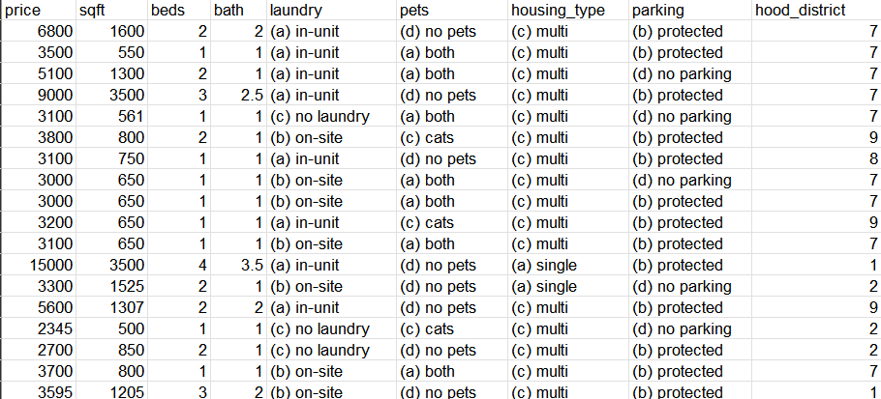
SF Housing Data (Raw)

Slide 6
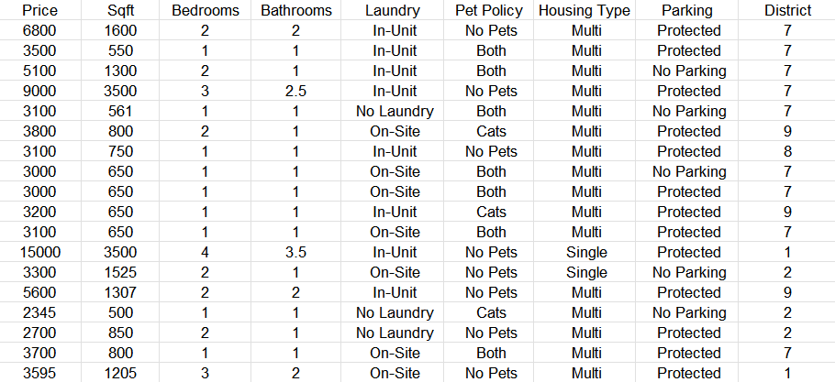
SF Housing Data (Cleaned)

Slide 7
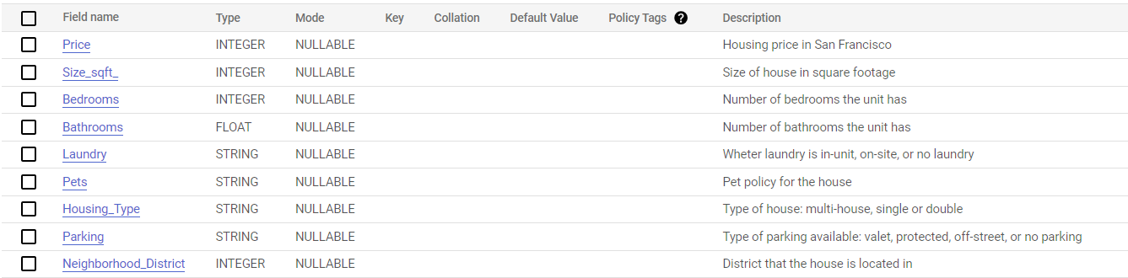
SF Housing Data (Schema)

Slide 8
DATA DASHBOARD
& ANALYSIS
02

Slide 9
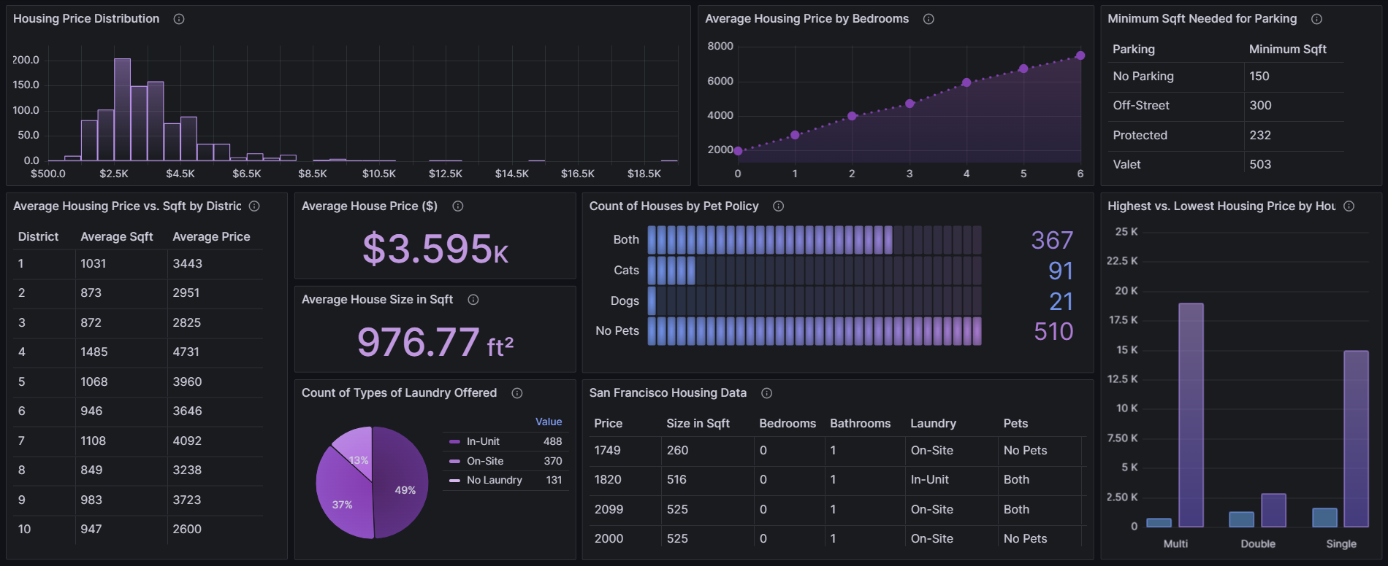
Original Dashboard

Slide 10
Feedback on Dashboard
FEEDBACK | CHANGES
Histogram’s maximum might need to be cut off at 8,000 | Did not set maximum value at 8,000 Upper values (outliers) will be explained during analysis
Title for table “Minimum Sq ft Needed for Parking” needs to be updated | Updated table title to “Smallest House by Parking Options”
Full table data should show at the bottom of the page at full width and reconfigure the panels | Updated layout to show full data at the bottom and reorganized panels

Slide 11
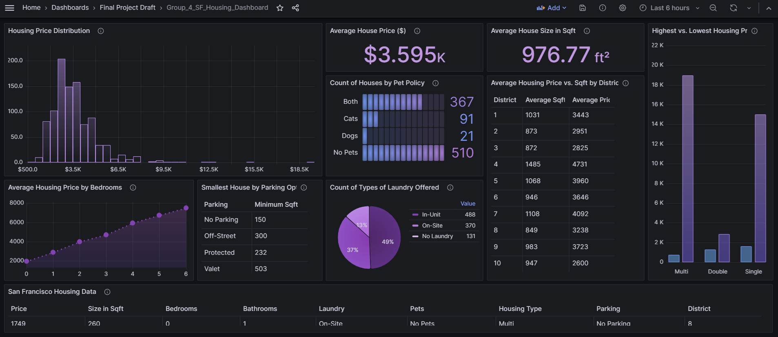
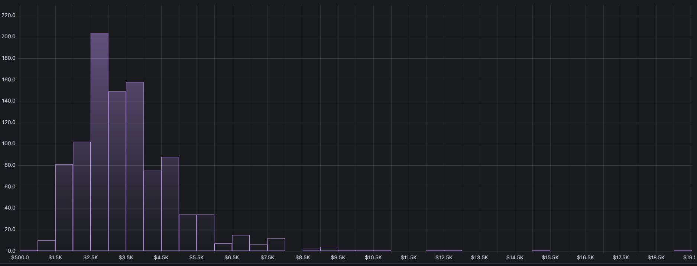
Updated Dashboard

Slide 12
Histogram of Price Distribution

Slide 13
95% of houses
The price distribution mostly fall between $1,500 to $8,000
The most common rent we can find in San Francisco is around $3,000 with more than 200 units available
The least common rent will be from $8,500 to $19,000
Notes:
920 houses in the range of 1500 to 6000, which is 93%

Slide 14
The price distribution mostly fall between $1,500 to $8,000
The most common rent we can find in San Francisco is around $3,000 with more than 200 units available
The least common rent will be from $8,500 to $19,000
5% of houses

Slide 15
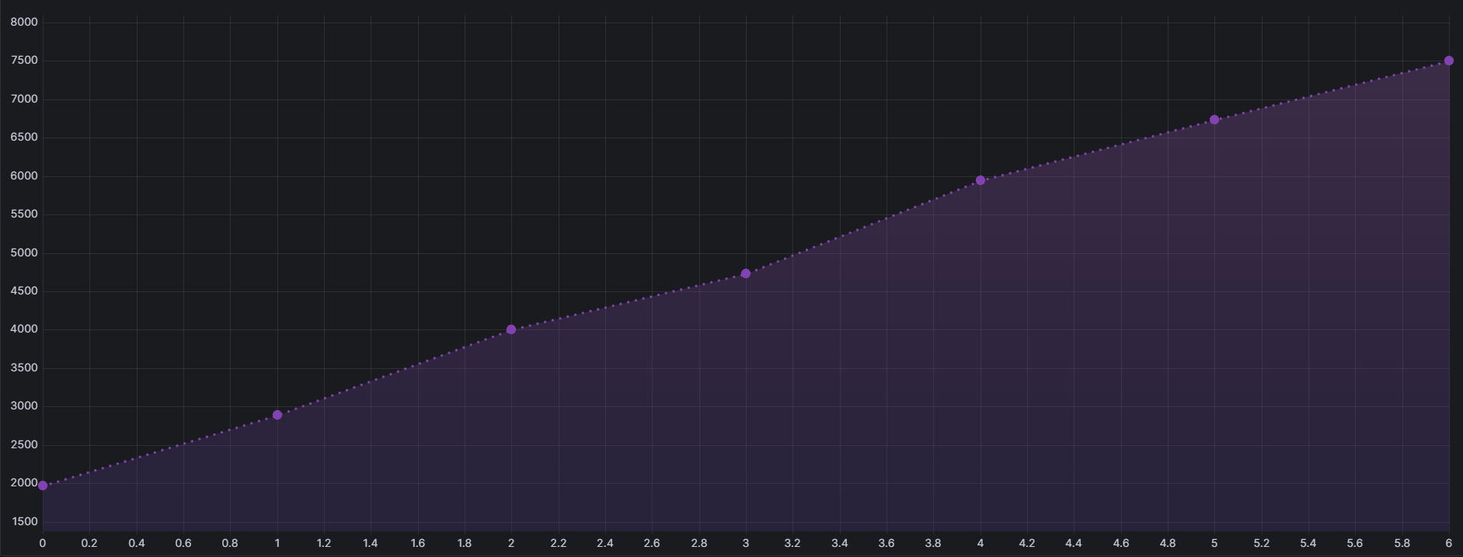
Average Housing Price
by Bedrooms

Slide 16
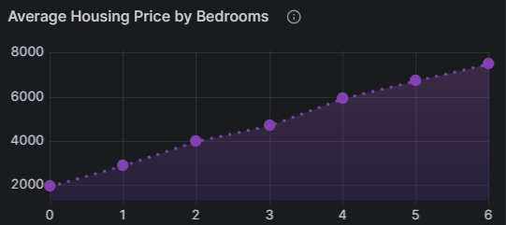
Average Housing Price
by Bedrooms
Positive correlation between number of bedrooms and average housing prices
More bedrooms equals to higher prices
Potential premium for additional living space
Renters can use this as a reference when determining the average price range needed based on bedrooms preferences
Notes:
The trend chart reveals a positive correlation between the number of bedrooms and average housing prices.
Larger homes with more bedrooms tend to command higher prices, indicating a potential premium for additional living space.
Buyers can quickly determine the average price ranges for various bedroom configurations, assisting homebuyers and real estate investors in making well-informed decisions.
Starting at 0 bedroom, the average price is already $2,000. Prices tend to go up by approximately $1,000 for every bedroom that you want to add

Slide 17
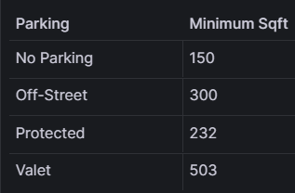
Parking in
San Francisco
San Francisco is a walkable city so if you do not have a car, the smallest space available for you is 150 sq ft
Minimum space needed will increase based on your parking preferences
San Francisco also offers various public transportations such as Muni, Bart, etc.
Notes:
San Francisco features restricted parking zones,necessitating alternative transportation. Off-street parking, including garages and lots, provides convenient options. Protected parking, like covered spaces, offers advantages in variable weather. Valet services, emphasizing user convenience,operate strategically in the city, catering to its unique parking challenges.

Slide 18
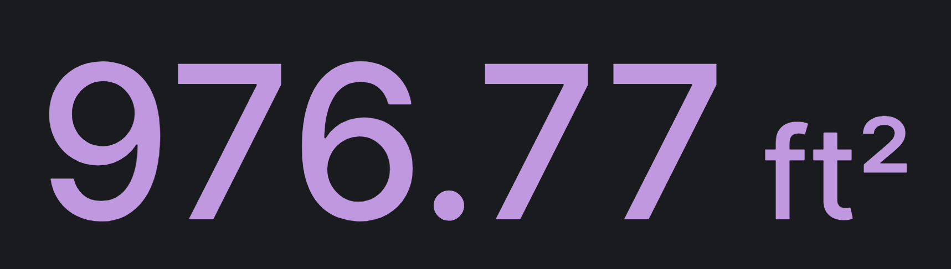
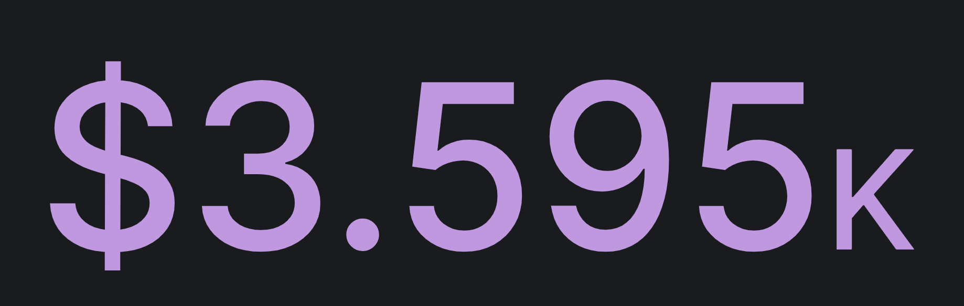

Slide 19
Average House Size
This panel tells us the typical average size of houses in the San Francisco housing market, based on our data.
Average House Price
Panel tells us the overall average price house
The average house price in San Francisco is very high given the average size they have

Slide 20
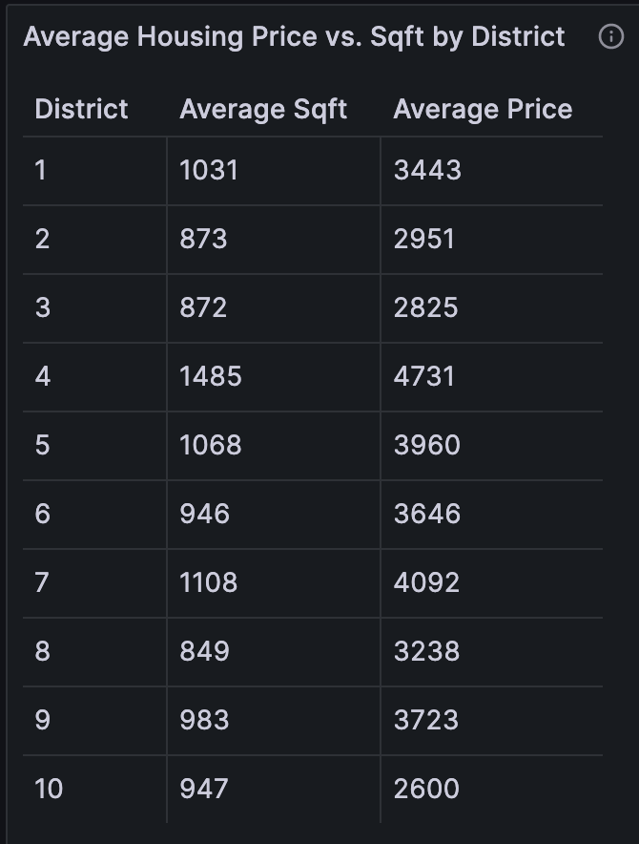
Average Housing Price vs. Size by District
Table that contrasts the average prices and sizes of houses across different districts
The highest average sq ft and highest average price of houses is in district 4.
The lowest average sq ft is in district 8 and the lowest average price is in district 10.
Average house prices are still very expensive when the sq ft is small.

Slide 21
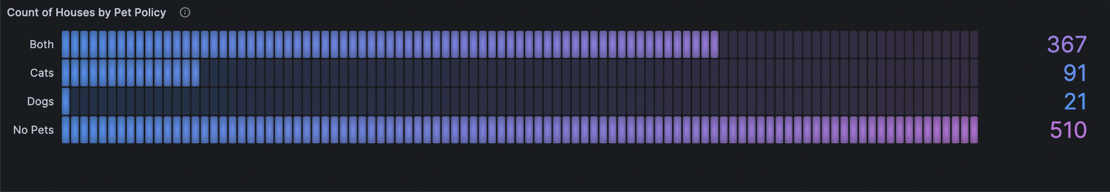
Pet Friendly Apartments
Out of 900+ houses, more than half do not allow pets
Less than 21 places allow dog-only
Landlords typically prefer cats than dogs
Percentage to find a place that allow pets is 48.4%
Visual snapshot of current house availability, with breakdown based on distinct pet policies
Notes:
In the San Francisco housing scene, imagine the bar gauge as your handy tool for checking out pet policies – it shows whether dogs, cats, both, or none are welcome. This breakdown is like your go-to helper, making it easy to make quick and smart decisions. It's especially important in a city where people have all sorts of preferences when it comes to furry friends. So, if you're on the hunt for a place to live in this bustling market, this feature ensures you have a smooth and informed experience, making the whole process a lot more user-friendly.

Slide 22
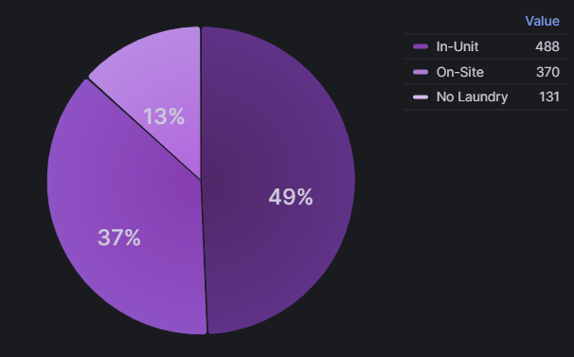
Laundry Availability in San Francisco
49%
37%
In-Unit
ON-Site
Pro: Convenience & Privacy
Con: Space Constraints
Pro:
Close-by
Con: Shared Laundromats; Have to pay
13%
No Laundry
Pro: loading..
Con: Inconvenience; Have to leave building; Have to pay
Notes:
In San Francisco, apartment laundry preferences reveal a diverse landscape. With 37% favoring on-site facilities, residents value communal convenience. Meanwhile, 49% prefer the luxury of in-unit laundry, emphasizing personal convenience. Surprisingly, 13% opt for no on-site laundry, potentially prioritizing other amenities or cost considerations. This mix reflects the varied needs and lifestyles within the city.

Slide 23
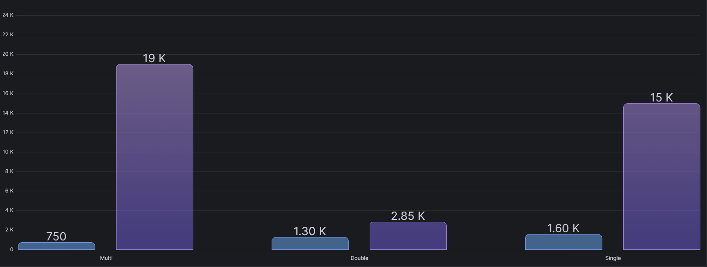
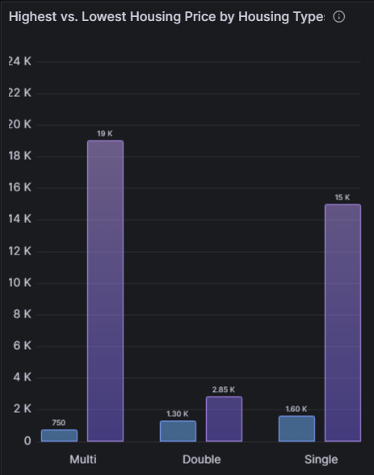
Highest vs. Lowest Price
by Housing Types

Slide 24
Multi-Family Houses
Offers variety of houses, caters to different budget with ranges from $750 to $19,000
Double-Family Houses
Perfect for families, boasts consistent pricing trend, falling between $1,300 to $2,850
Single-Family Houses
Stand-alone homes with diverse price range, reflecting variations in sizes, amenities, and locations, spanning from $1,600 to $15,000

Slide 25
03
SUGGESTIONS

Slide 26
BUDGET AWARENESS
Understand your budget
Our data recommends budget range of $1,500 to $6,000 depending on different needs and preferences
EXPLORE HOUSING TYPES
Multi-Family place for budget variety,
Double-Family for consistency pricing, and Single-Family for variety options
CONSIDER DISTRICTS
Districts matter. Analyze district variations to align your choices with your envisioned lifestyle

Slide 27
BUDGET AWARENESS
Understand your budget
Our data recommends budget range of $1,500 to $6,000 depending on different needs and preferences
EXPLORE HOUSING TYPES
Multi-Family place for budget variety,
Double-Family for consistency pricing, and Single-Family for variety options
CONSIDER DISTRICTS
Districts matter. Analyze district variations to align your choices with your envisioned lifestyle

Slide 28
04
CONCLUSIONS
Diverse Market
House Size Matters
Pets & Amenities
Tailor Your Choice
SF housing market is diverse
Histogram shows widespread options for those looking to upgrade or first-time homebuyers
Consider area
Find a home that fits your lifestyle
Refer to the average size panel snapshot for more information
Pet policies & amenities from bar gauge & pie chart
Be prepared for house search if you have pets or prefer in-unit laundry
Bar chart illustrates housing options based on pricing (min & max)
Know what you want and need for a perfect fit

Slide 29
Answers to Stakeholders’ Questions
What is a reasonable budget range to live in SF?
What are the amenities that SF houses offers?
How much space do I have if I want to live in SF?

Slide 30
Answers to Stakeholders’ Questions
What is a reasonable budget range to live in SF?
What are the amenities that SF houses offers?
How much space do I have if I want to live in SF?
$2,000 to $3,500 for single
$4,000 for family
Refer to histogram, trend chart, comparison tables

Slide 31
Answers to Stakeholders’ Questions
What is a reasonable budget range to live in SF?
What are the amenities that SF houses offers?
How much space do I have if I want to live in SF?
$2,000 to $3,500 for single
$4,000 for family
Refer to histogram, trend chart, comparison tables
Laundry, pet policy, parking
Prices vary depending on amenities available
Refer to pie chart & bar gauge

Slide 32
Answers to Stakeholders’ Questions
What is a reasonable budget range to live in SF?
What are the amenities that SF houses offers?
How much space do I have if I want to live in SF?
$2,000 to $3,500 for single
$4,000 for family
Refer to histogram, trend chart, comparison tables
Laundry, pet policy, parking
Prices vary depending on amenities available
Refer to pie chart & bar gauge
Average house size is 977 sqft
Sizes depend on personal preferences & amenities needed
Refer to comparison tables & stat visual

Slide 33
THANKS!
Do you have any questions?
Click to Grafana Dashboard

